Slide 1
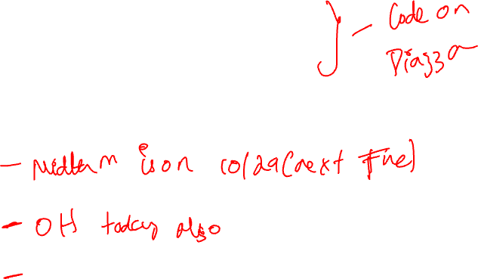
BIAS VARIANCE TRADEOFF
Chapter 17.6

Slide 2
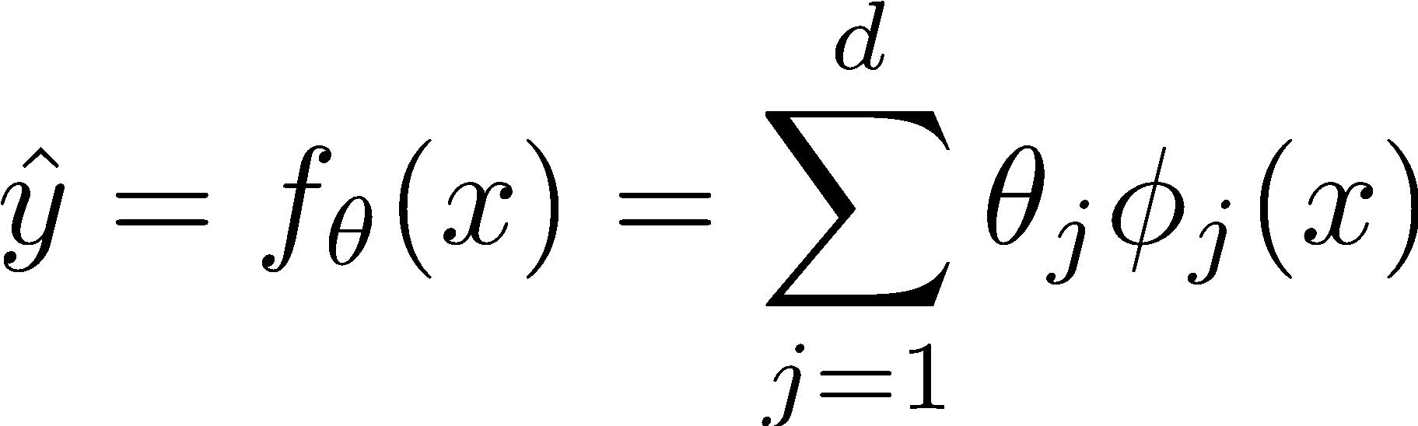





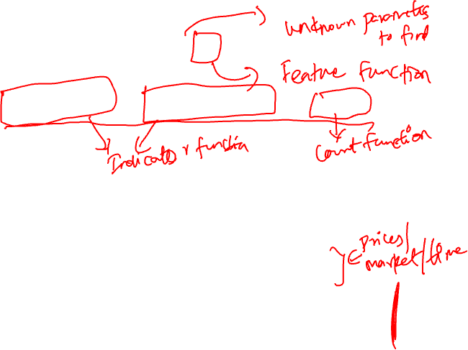
LINEAR MODELS AND FEATURE FUNCTIONS
Domain:
Model:
Indicator functions
are a common method to transform qualitative data into quantitative data.
Polynomial features capture nonlinearity
Linear models are linear in features and parameters (but not in raw/input data)
Features:

Slide 3
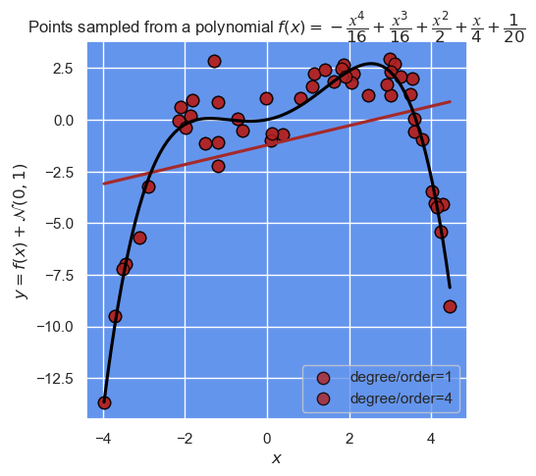
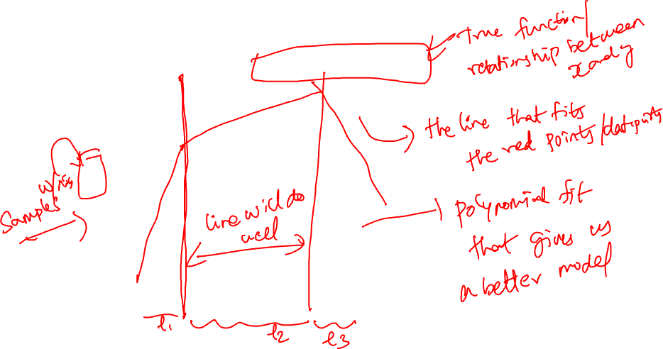
With the columns added can obtain the true fit using linear model regression

Slide 4
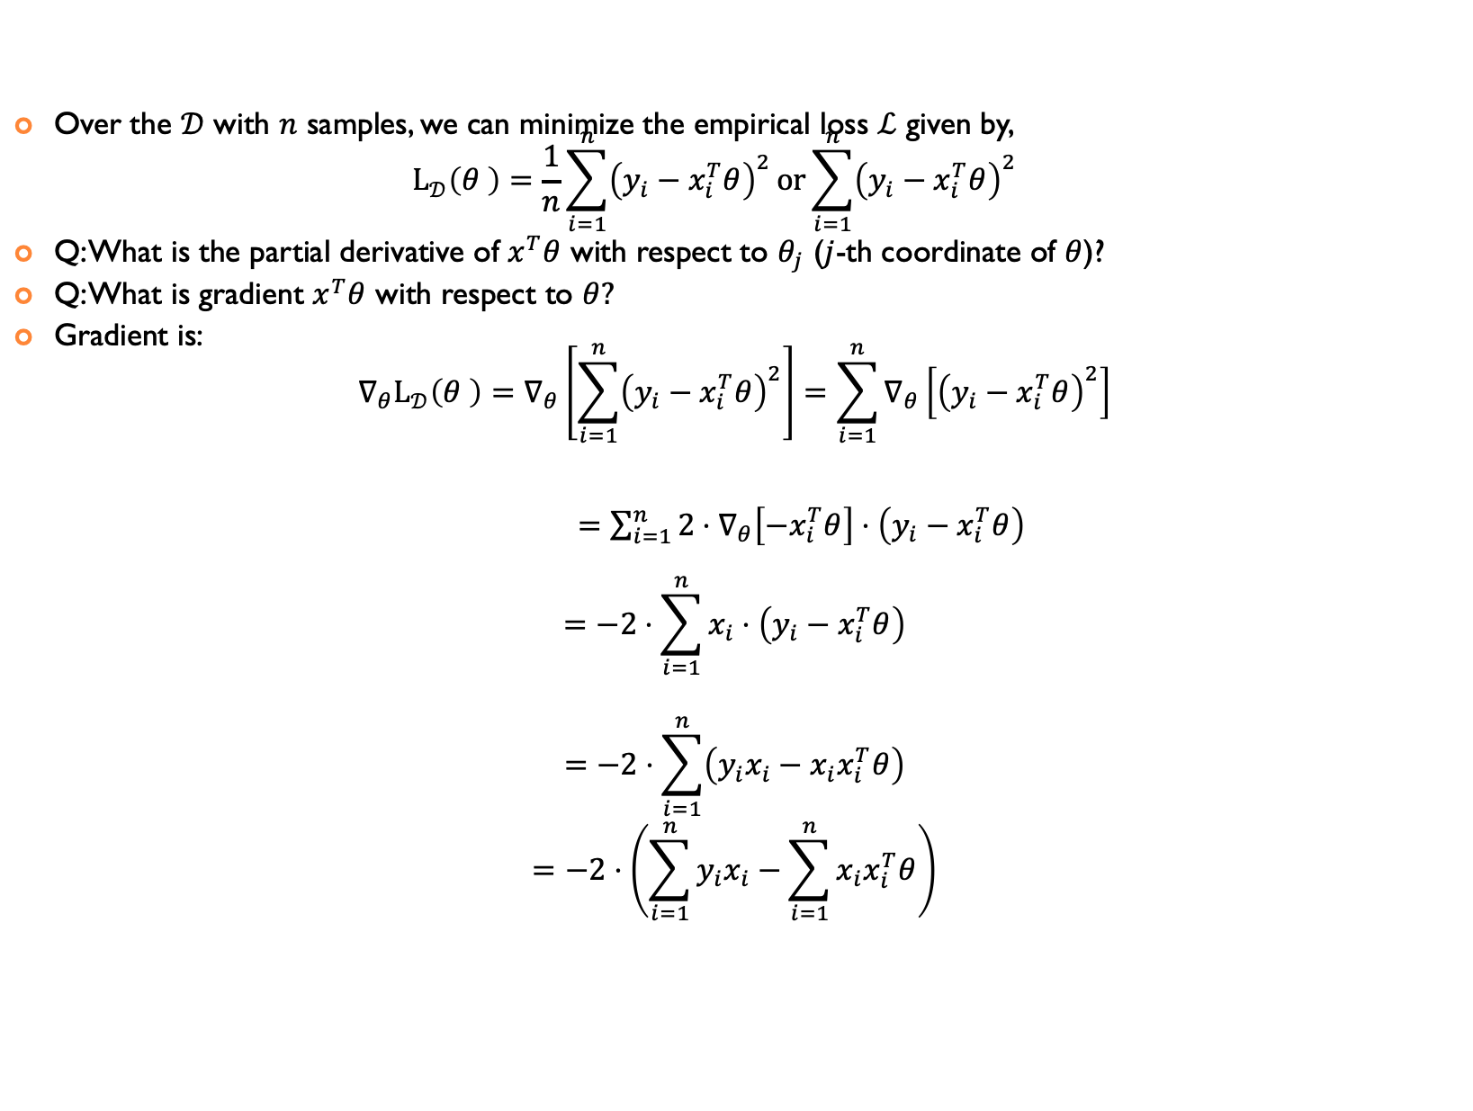
STEP 1: LOSS AND GRADIENT (TAKING DERIVATIVE)
Over the $𝒟$ with $n$ samples, we can minimize the empirical loss $ℒ$ given by, $L_{𝒟}\left(θ \right)=\frac{1}{n}\sum_{i=1}^{n}{{\left(y_{i}−x_{i}^{T}θ\right)}^{2}}or\sum_{i=1}^{n}{{\left(y_{i}−x_{i}^{T}θ\right)}^{2}}$
Q: What is the partial derivative of $x^{T}θ$ with respect to $θ_{j}$ ($j$-th coordinate of $θ$)?
Q: What is gradient $x^{T}θ$ with respect to $θ?$
Gradient is: $∇_{θ}L_{𝒟}\left(θ \right)=∇_{θ}\left[\sum_{i=1}^{n}{{\left(y_{i}−x_{i}^{T}θ\right)}^{2}}\right]=\sum_{i=1}^{n}{∇_{θ}\left[{\left(y_{i}−x_{i}^{T}θ\right)}^{2}\right]}$
$=\sum_{i=1}^{n}{2⋅∇_{θ}\left[{−x}_{i}^{T}θ\right]⋅\left(y_{i}−x_{i}^{T}θ\right)}$
$$=−2⋅\sum_{i=1}^{n}{x_{i}⋅\left(y_{i}−x_{i}^{T}θ\right)}$$
$$=−2⋅\sum_{i=1}^{n}{\left(y_{i}x_{i}−{x_{i}x}_{i}^{T}θ\right)}$$
$$=−2⋅\left(\sum_{i=1}^{n}{y_{i}x_{i}−\sum_{i=1}^{n}{x_{i}x_{i}^{T}θ}}\right)$$

Slide 5
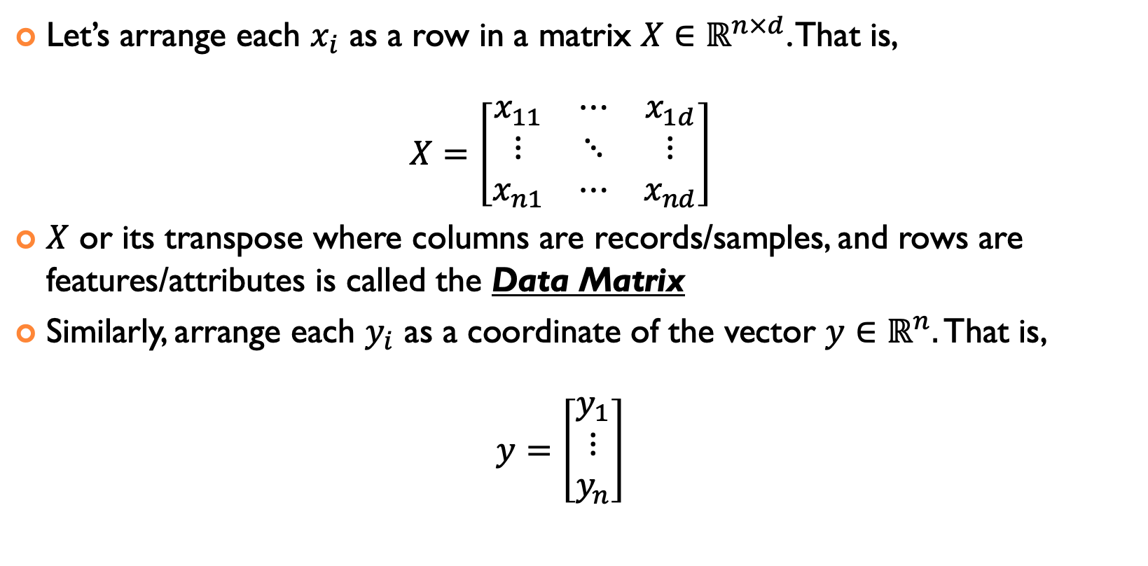
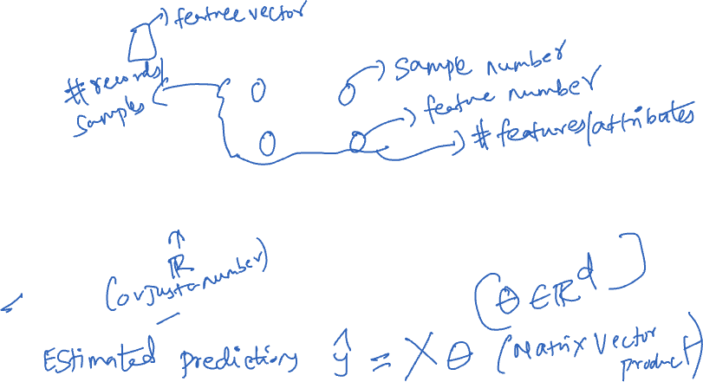
TO SOLVE FOR PARAMETERS, REWRITE IN MATRIX FORM
Let’s arrange each $x_{i}$ as a row in a matrix $X∈ℝ^{n×d}$. That is, $X=\left[\begin{matrix}x_{11} & ⋯ & x_{1d} \\ ⋮ & ⋱ & ⋮ \\ x_{n1} & ⋯ & x_{nd}\end{matrix}\right]$
$X$ or its transpose where columns are records/samples, and rows are features/attributes is called the Data Matrix
Similarly, arrange each $y_{i}$ as a coordinate of the vector $y∈ℝ^{n}.$ That is, $y=\left[\begin{matrix}y_{1} \\ ⋮ \\ y_{n}\end{matrix}\right]$

Slide 6
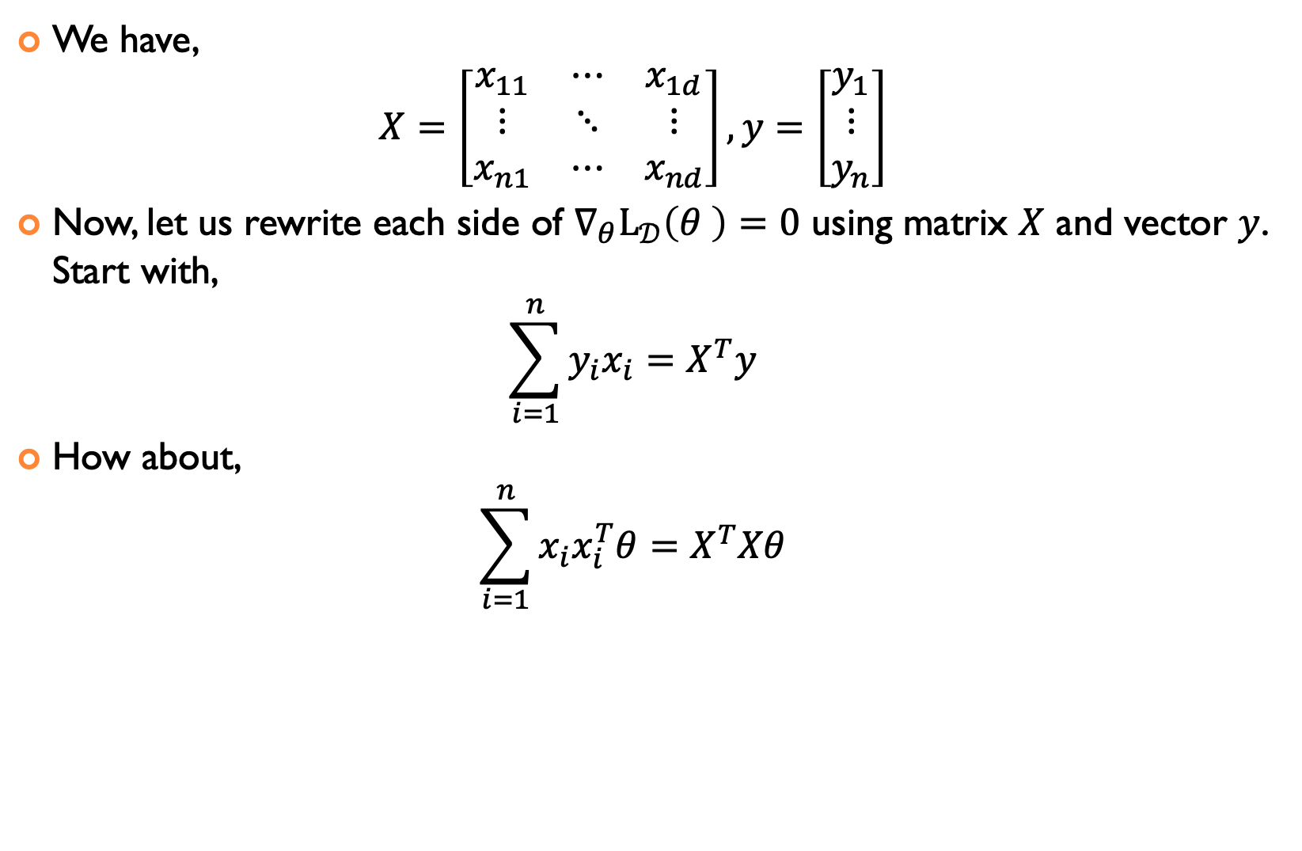
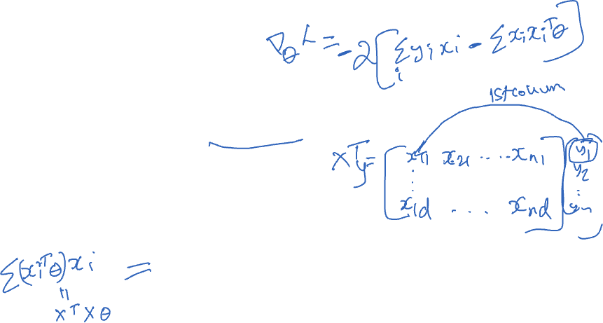
TO SOLVE FOR PARAMETERS, REWRITE IN MATRIX FORM
We have, $X=\left[\begin{matrix}x_{11} & ⋯ & x_{1d} \\ ⋮ & ⋱ & ⋮ \\ x_{n1} & ⋯ & x_{nd}\end{matrix}\right],y=\left[\begin{matrix}y_{1} \\ ⋮ \\ y_{n}\end{matrix}\right]$
Now, let us rewrite each side of $∇_{θ}L_{𝒟}\left(θ \right)=0$ using matrix $X$ and vector $y$. Start with, $\sum_{i=1}^{n}{y_{i}x_{i}}=X^{T}y$
How about, $\sum_{i=1}^{n}{x_{i}x_{i}^{T}θ}=X^{T}Xθ$

Slide 7
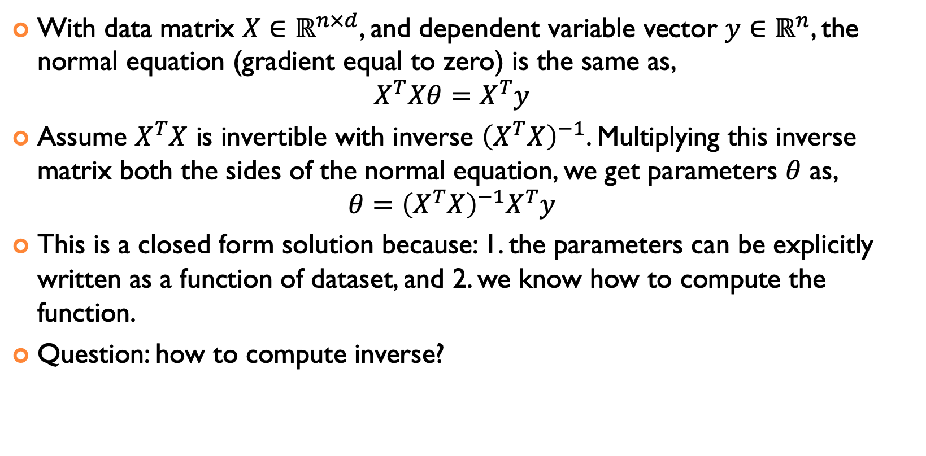
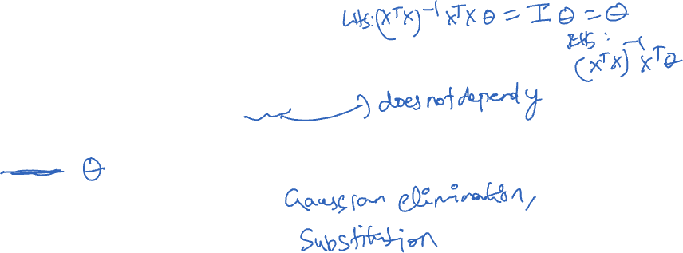
STEP 3: SOLVE FOR PARAMETERS
With data matrix $X∈ℝ^{n×d}$, and dependent variable vector $y∈ℝ^{n}$, the normal equation (gradient equal to zero) is the same as, $X^{T}Xθ=X^{T}y$
Assume $X^{T}X$ is invertible with inverse ${\left(X^{T}X\right)}^{−1}$. Multiplying this inverse matrix both the sides of the normal equation, we get parameters $θ$ as, $θ={\left(X^{T}X\right)}^{−1}X^{T}y$
This is a closed form solution because: 1. the parameters can be explicitly written as a function of dataset, and 2. we know how to compute the function.
Question: how to compute inverse?

Slide 8
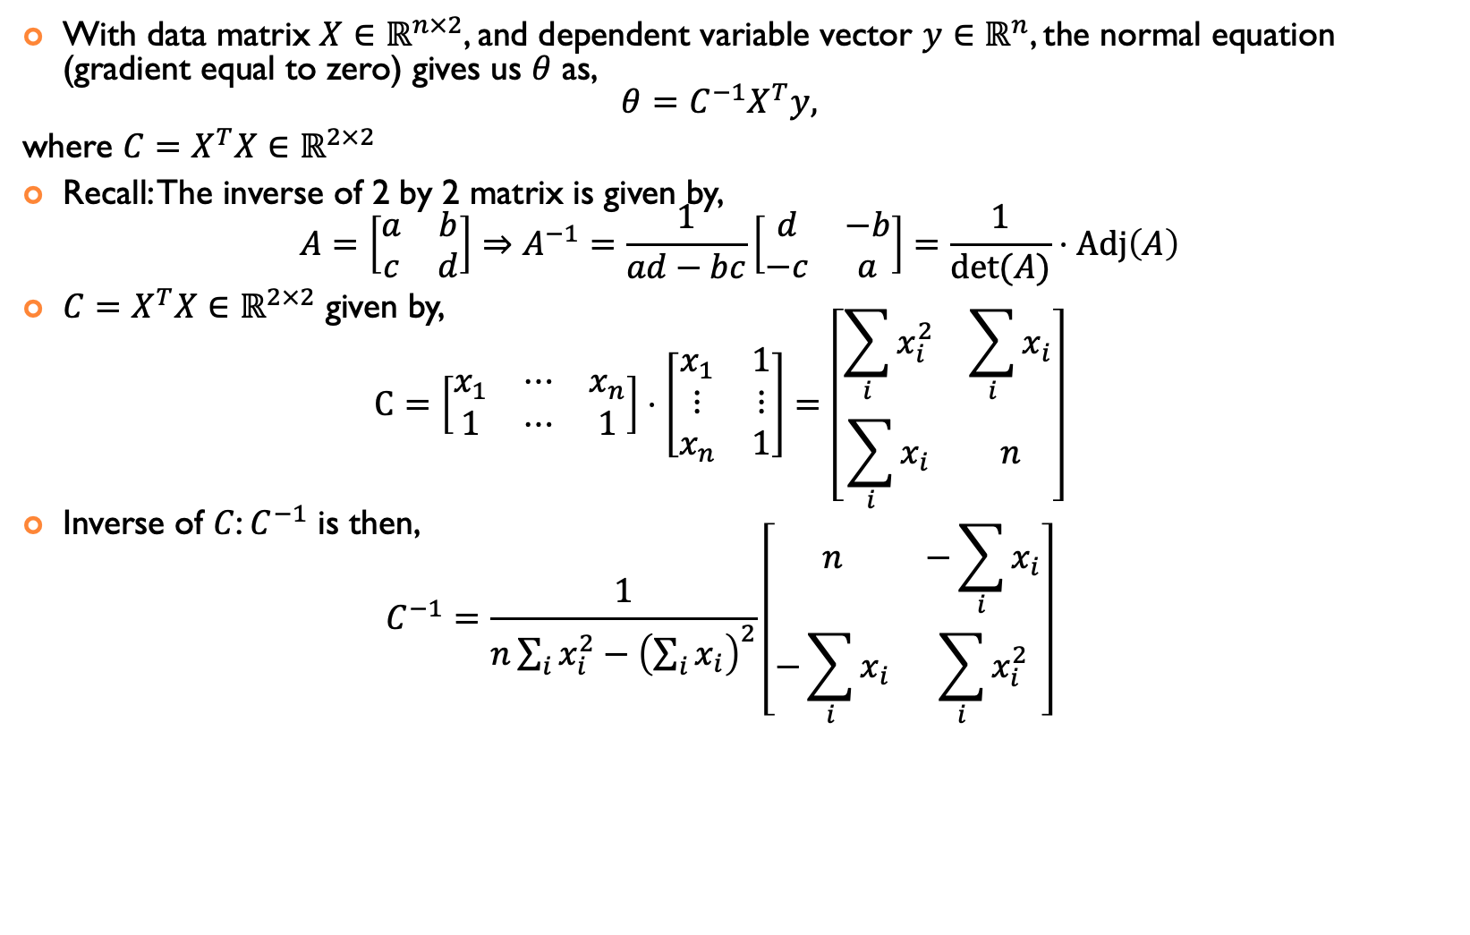
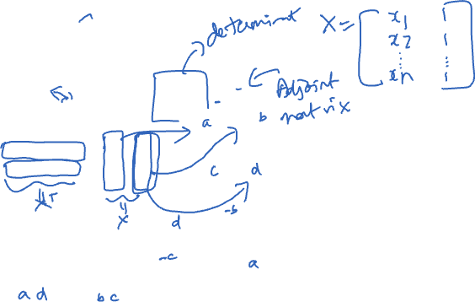
CHECK THE FORMULA FOR THE SIMPLE LINEAR MODEL
With data matrix $X∈ℝ^{n×2}$, and dependent variable vector $y∈ℝ^{n}$, the normal equation (gradient equal to zero) gives us $θ$ as, $θ=C^{−1}X^{T}y,$
where ${C=X}^{T}X∈ℝ^{2×2}$
Recall: The inverse of 2 by 2 matrix is given by, $A=\left[\begin{matrix}a & b \\ c & d\end{matrix}\right]⇒A^{−1}=\frac{1}{ad−bc}\left[\begin{matrix}d & −b \\ −c & a\end{matrix}\right]=\frac{1}{det⁡(A)}⋅\text{Adj}\left(A\right)$
${C=X}^{T}X∈ℝ^{2×2}$ given by, $C=\left[\begin{matrix}x_{1} & ⋯ & x_{n} \\ 1 & ⋯ & 1\end{matrix}\right]⋅\left[\begin{matrix}x_{1} & 1 \\ ⋮ & ⋮ \\ x_{n} & 1\end{matrix}\right]=\left[\begin{matrix}\sum_{i}{x_{i}^{2}} & \sum_{i}{x_{i}} \\ \sum_{i}{x_{i}} & n\end{matrix}\right]$
Inverse of $C$: $C^{−1}$ is then, $C^{−1}=\frac{1}{n\sum_{i}{x_{i}^{2}}−{\left(\sum_{i}{x_{i}}\right)}^{2}}\left[\begin{matrix}n & −\sum_{i}{x_{i}} \\ −\sum_{i}{x_{i}} & \sum_{i}{x_{i}^{2}}\end{matrix}\right]$
Notes:
(I mistakenly said “Adjoint” when it is actually supposed to be “Adjugate “matrix

Slide 9
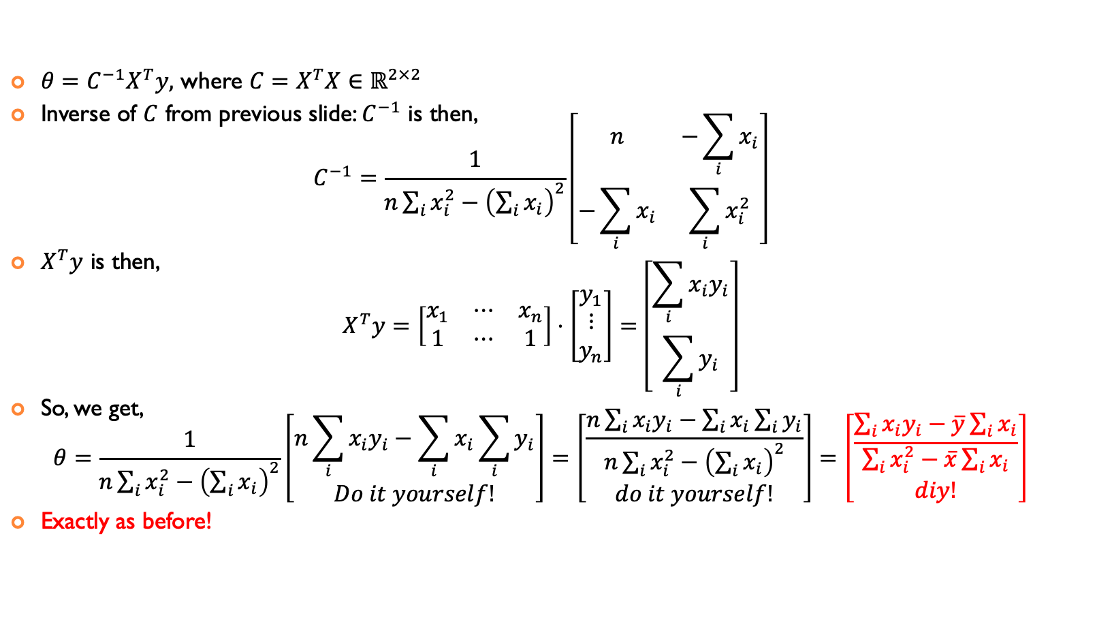
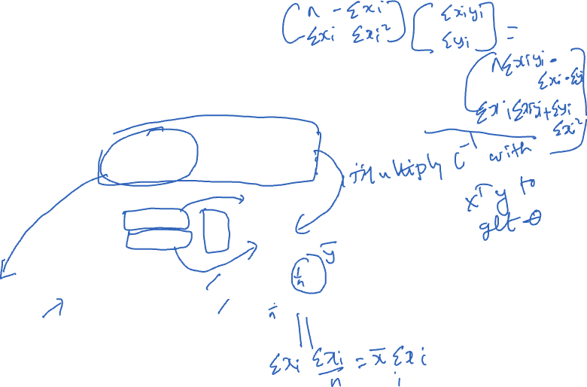
CHECK THE FORMULA FOR THE SIMPLE LINEAR MODEL
$θ=C^{−1}X^{T}y,$ where ${C=X}^{T}X∈ℝ^{2×2}$
Inverse of $C$ from previous slide: $C^{−1}$ is then, $C^{−1}=\frac{1}{n\sum_{i}{x_{i}^{2}}−{\left(\sum_{i}{x_{i}}\right)}^{2}}\left[\begin{matrix}n & −\sum_{i}{x_{i}} \\ −\sum_{i}{x_{i}} & \sum_{i}{x_{i}^{2}}\end{matrix}\right]$
$X^{T}y$ is then, $X^{T}y=\left[\begin{matrix}x_{1} & ⋯ & x_{n} \\ 1 & ⋯ & 1\end{matrix}\right]⋅\left[\begin{matrix}y_{1} \\ ⋮ \\ y_{n}\end{matrix}\right]=\left[\begin{matrix}\sum_{i}{x_{i}y_{i}} \\ \sum_{i}{y_{i}}\end{matrix}\right]$
So, we get, $θ=\frac{1}{n\sum_{i}{x_{i}^{2}}−{\left(\sum_{i}{x_{i}}\right)}^{2}}\left[\begin{matrix}n\sum_{i}{x_{i}y_{i}}−\sum_{i}{x_{i}}\sum_{i}{y_{i}} \\ Do it yourself!\end{matrix}\right]=\left[\begin{matrix}\frac{n\sum_{i}{x_{i}y_{i}}−\sum_{i}{x_{i}}\sum_{i}{y_{i}}}{n\sum_{i}{x_{i}^{2}}−{\left(\sum_{i}{x_{i}}\right)}^{2}} \\ do it yourself!\end{matrix}\right]=\left[\begin{matrix}\frac{\sum_{i}{x_{i}y_{i}−\overline{y}\sum_{i}{x_{i}}}}{\sum_{i}{x_{i}^{2}}−\overline{x}\sum_{i}{x_{i}}} \\ diy!\end{matrix}\right]$
Exactly as before!

Slide 10
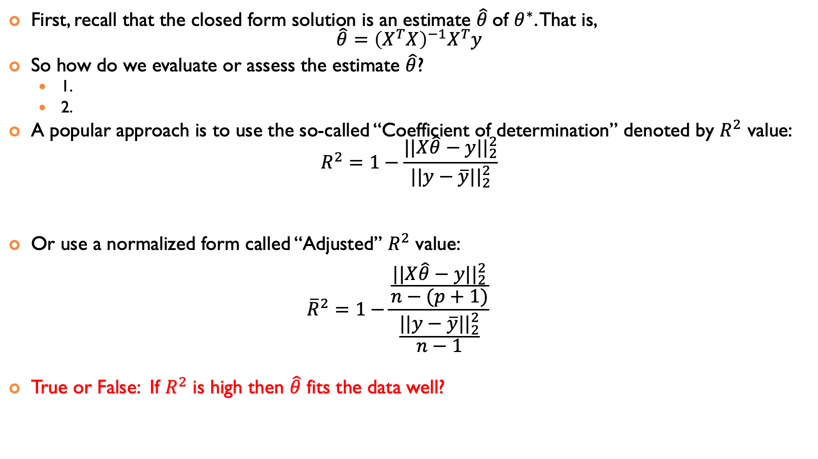
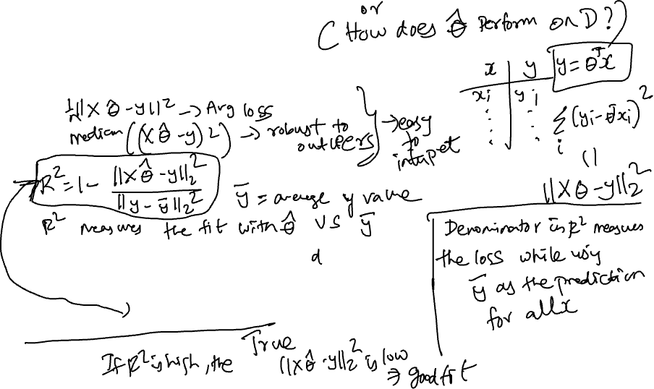
How to assess goodness of fit?
First, recall that the closed form solution is an estimate $\hat{θ}$of $θ^{∗}$. That is, $\hat{θ}={\left(X^{T}X\right)}^{−1}X^{T}y$
So how do we evaluate or assess the estimate $\hat{θ}$?
1.
2.
A popular approach is to use the so-called “Coefficient of determination” denoted by $R^{2}$ value: $R^{2}=1−\frac{||X\hat{θ}−y||_{2}^{2}}{||y−\overline{y}||_{2}^{2}}$
Or use a normalized form called “Adjusted” $R^{2}$ value: ${\overline{R}}^{2}=1−\frac{\frac{||X\hat{θ}−y||_{2}^{2}}{n−(p+1)}}{\frac{||y−\overline{y}||_{2}^{2}}{n−1}}$
True or False: If $R^{2}$ is high then $\hat{θ}$ fits the data well?

Slide 11

What is BIAS in prediction?

Slide 12
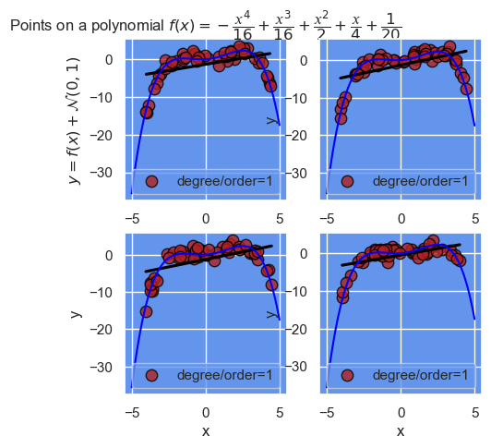
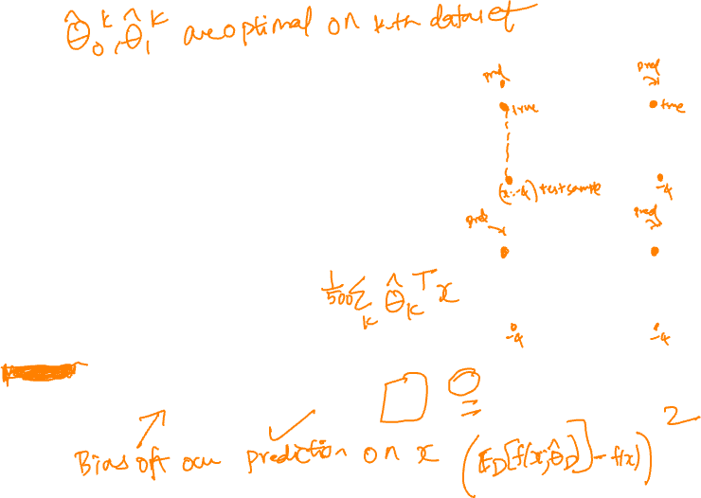
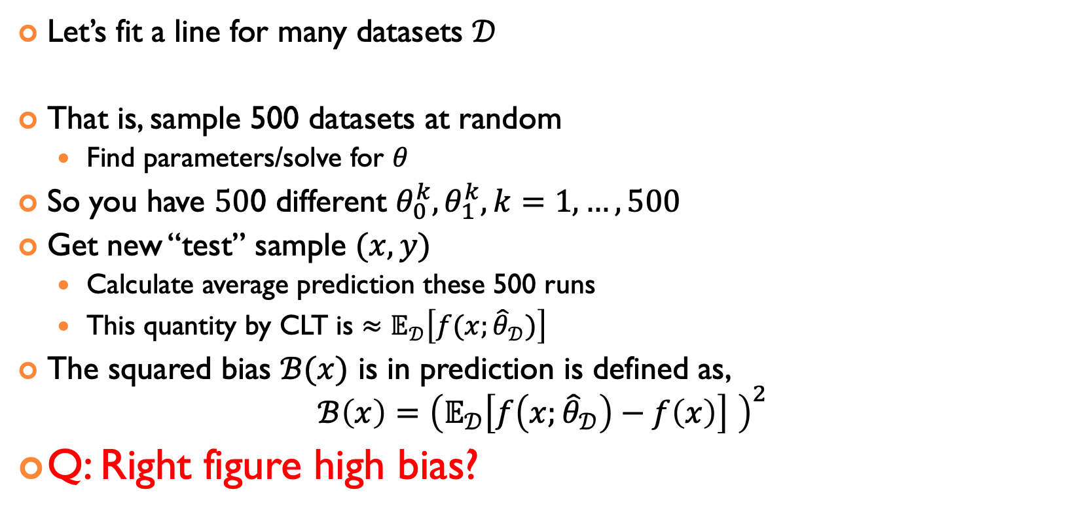
DEFINING BIAS
Let’s fit a line for many datasets $𝒟$
That is, sample 500 datasets at random
Find parameters/solve for $θ$
So you have $50$0 different $θ_{0}^{k},θ_{1}^{k}, k=1,…,500$
Get new “test” sample $(x,y)$
Calculate average prediction these 500 runs
This quantity by CLT is $≈𝔼_{𝒟}\left[f(x;{\hat{θ}}_{𝒟})\right]$
The squared bias $ℬ(x)$ is in prediction is defined as, $ℬ\left(x\right)={\left(𝔼_{𝒟}\left[f\left(x;{\hat{θ}}_{𝒟}\right)−f\left(x\right)\right] \right)}^{2}$
Q: Right figure high bias?

Slide 13
What is VARIANCE in prediction?

Slide 14
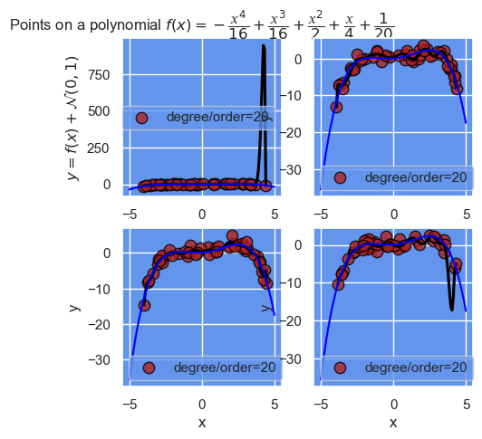
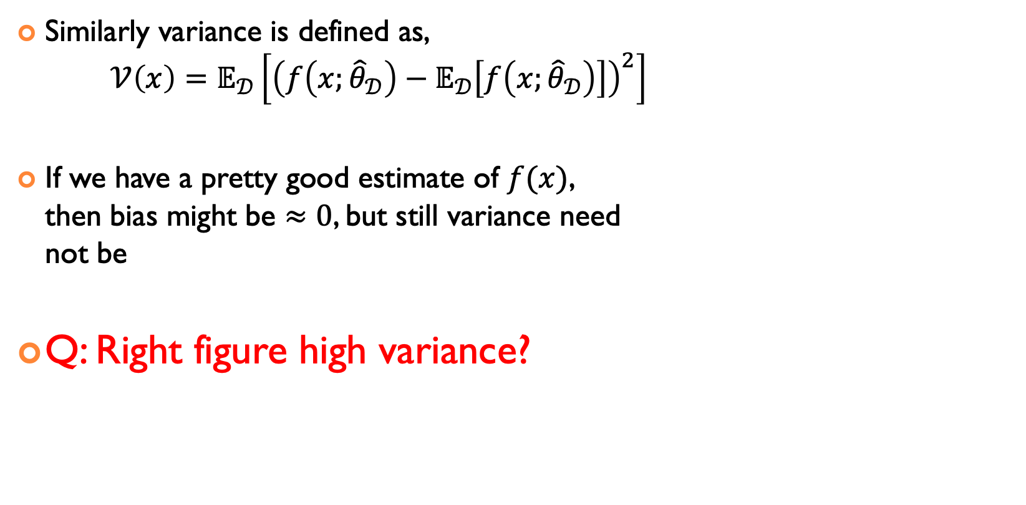
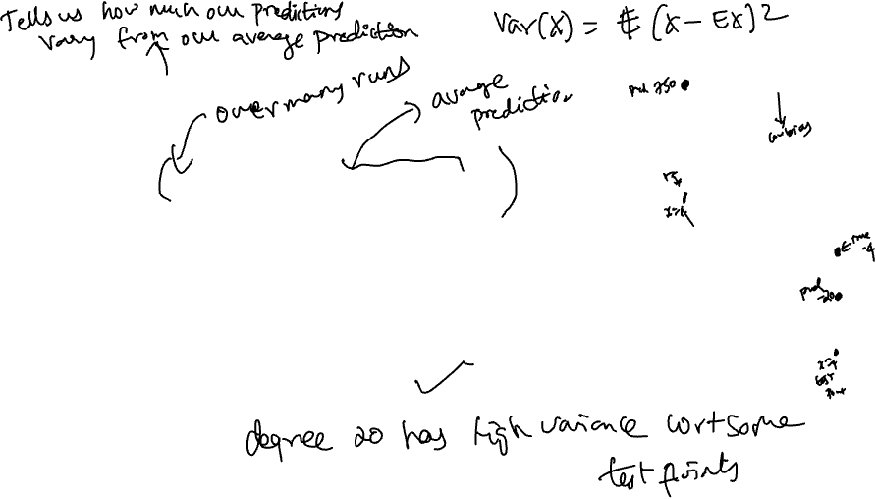
DEFINING VARIANCE
Similarly variance is defined as, ${𝒱\left(x\right)=𝔼}_{𝒟}\left[{\left(f\left(x;{\hat{θ}}_{𝒟}\right)−𝔼_{𝒟}\left[f\left(x;{\hat{θ}}_{𝒟}\right)\right]\right)}^{2}\right]$
If we have a pretty good estimate of $f(x)$, then bias might be $≈0$, but still variance need not be
Q: Right figure high variance?

Slide 15
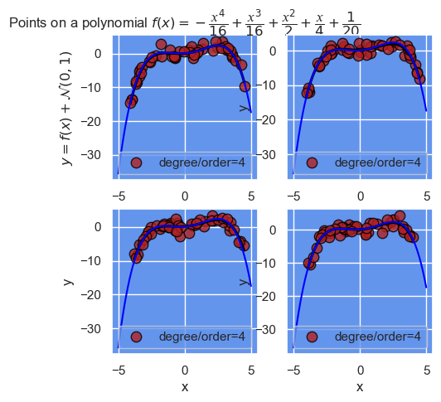
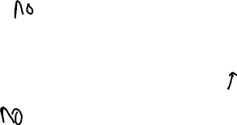
GOOD FIT
Q: Right figure high bias?
Q: Right figure high variance?

Slide 16
What is BIAS-VARIANCE TRADEOFF in prediction?

Slide 17
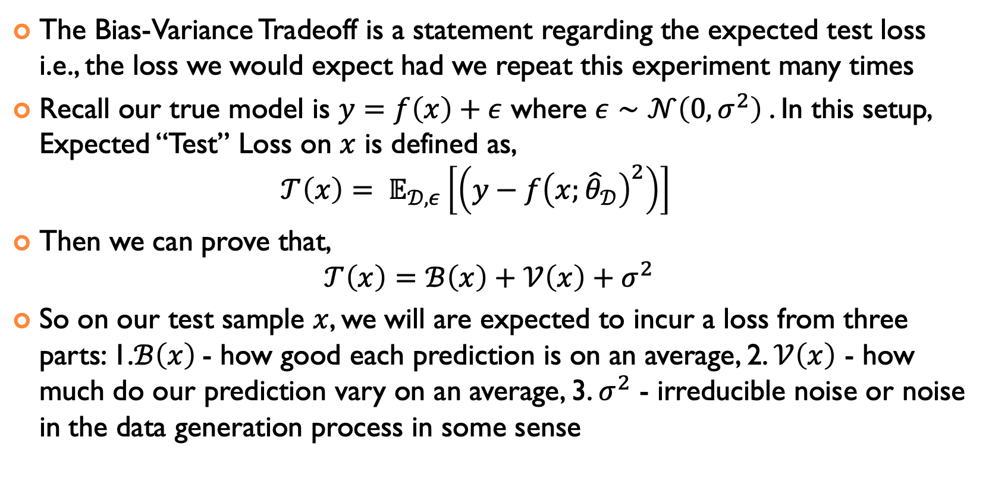
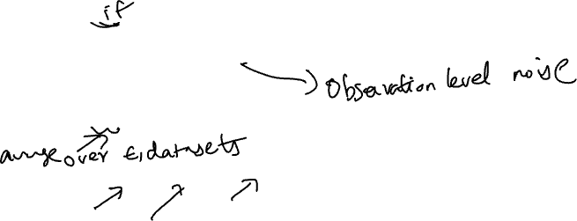
WHAT CAN WE SAY IF WE REPEAT THE EXPERIMENT
The Bias-Variance Tradeoff is a statement regarding the expected test loss i.e., the loss we would expect had we repeat this experiment many times
Recall our true model is $y=f\left(x\right)+ε$ where $ε∼𝒩\left(0,σ^{2}\right)$. In this setup, Expected “Test” Loss on $x$ is defined as, $𝒯\left(x\right)= 𝔼_{𝒟,ε}\left[\left(y−f{\left(x;{\hat{θ}}_{𝒟}\right)}^{2}\right)\right]$
Then we can prove that, $𝒯\left(x\right)=ℬ\left(x\right)+𝒱\left(x\right)+σ^{2}$
So on our test sample $x$, we will are expected to incur a loss from three parts: 1.$ℬ\left(x\right)$- how good each prediction is on an average, 2. $𝒱\left(x\right)$ - how much do our prediction vary on an average, 3. $σ^{2}$ - irreducible noise or noise in the data generation process in some sense

Slide 18
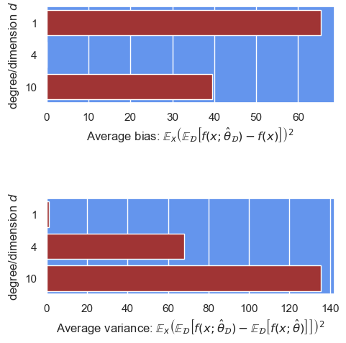

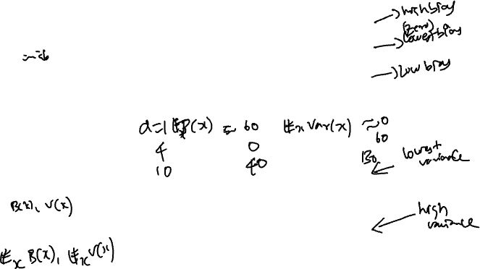
BIAS – VARIANCE TRADEOFF ILLUSTRATION
For each degree/order:
Collect many datasets for the same prediction
Find parameters for each dataset
Choose new/test set of points of independent variables $x$
For each test $x$, calculate bias, variance
Calculate average bias, average variance over all test points

